Slide 1
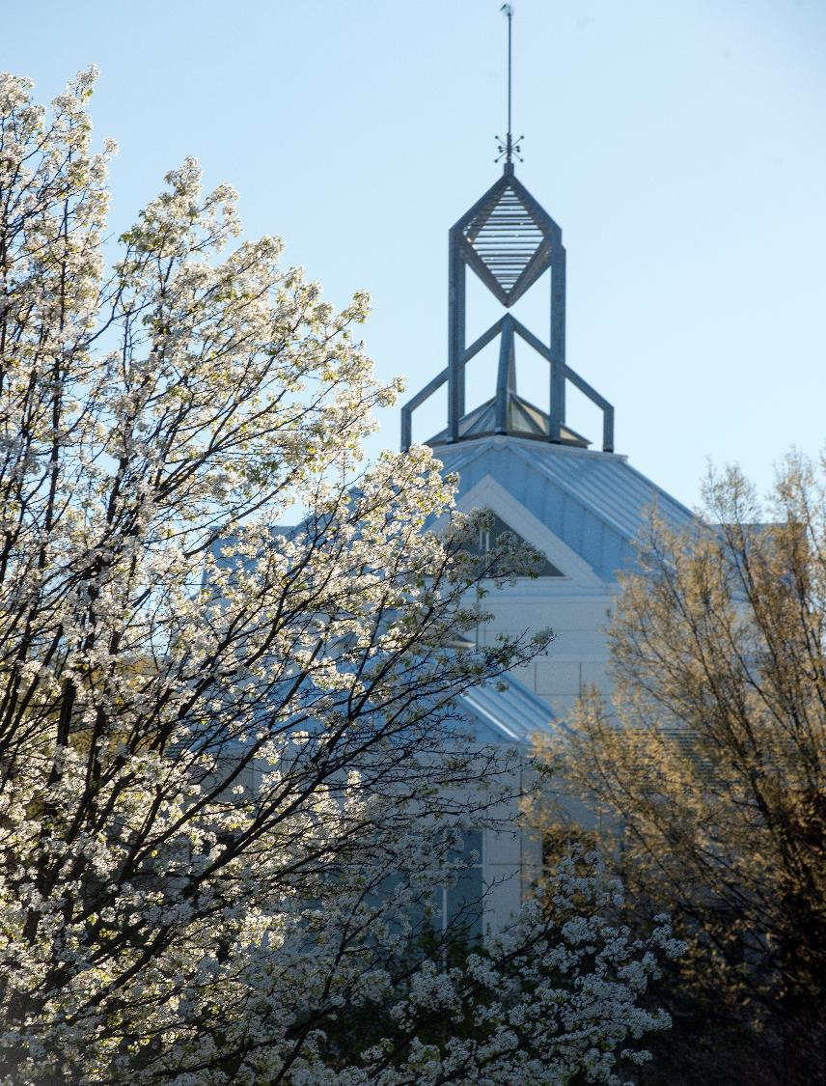
Invisible CAPTCHA v3 Bot (Red Team)
George Mason University
Picture can be company logo or team name or a graphic related to your project
Group 24
Anirudh, Bishesh, David, Diemmi, Hiten, Joseph
10/3/2025

Slide 2
Agenda
Problem Statement
Requirements and Design Constraints
Long-term Objectives
Technical Approach
Barriers and Risks
Outcomes
Resources Needed
Mid-Term Objectives – Schedule, Deliverables, Milestones
Roles & Responsibilities
Questions
Discussion with Sponsors

Slide 3
Problem Statement
The Problem
Web defense against bots is an ongoing battle. With the rise of AI, attackers can implement more advanced methods to bypass reCAPTCHA v3 implementations
Impact
Without sufficient anti-bot CAPTCHA implementations, web devs will experience stronger botting attacks and activities, decreasing desired website outcomes and experiences
Importance to the Sponsor
This project expands current knowledge on CAPTCHA vulnerabilities and can be used to research countermeasures against potential exploitations
Notes:
Anirudh, Bishesh, David, Diemmi, Hiten, Joseph

Slide 4
Requirement and Constraint Examples
Requirements
Software: Use Python as a backend and open a headless browser for web scraping(i.e. Selenium)
Program: Testing with two autonomous versions. First version is headless with no mouse movements and keyboard inputs. Second version shown the GUI with humanized mouse movements and keyboard inputs controlled by an AI model.
Design Constraints
Cannot violate TOS for browsers that we use (?)
Only one bot can run at a time (no DDoS attacks)
Cannot use CAPTCHA farms
Notes:
Anirudh, Bishesh, David, Diemmi, Hiten, Joseph

Slide 5
Long Term Objectives
Successfully implement a CAPTCHA bot that can bypass (Invisible) reCAPTCHAv3 services without prompting v2 on Blue Team website by March 2026
Successfully implement a CAPTCHA bot that can bypass reCAPTCHAv3 services across multiple vendors
Successfully implement a CAPTCHA bot that can bypass reCAPTCHAv3 services on majority of public websites
Notes:
Anirudh, Bishesh, David, Diemmi, Hiten, Joseph

Slide 6
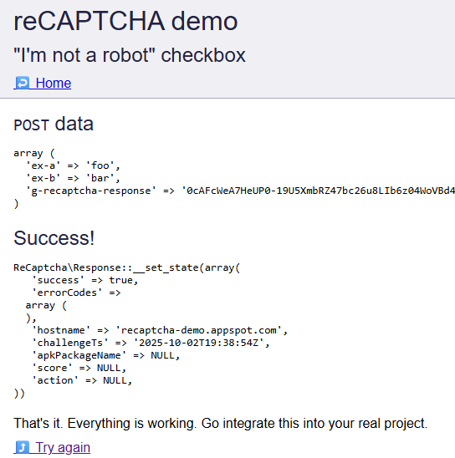
Long Term Objectives
Supporting Graphics
Notes:
Anirudh, Bishesh, David, Diemmi, Hiten, Joseph

Slide 7
Technical Approach
Phase 1: “Robosynthesis”
Phase 2: Test Against Blue Team Website
Research CAPTCHA v3 methods including ways they detect and flag anomalous behavior
Program the bot using python libraries that allow autonomous scraping with AI model(s) for mouse movement and keyboard input
Once Blue team release their website, our bot will attempt to interact with it
Bot will log into the website while trying to avoid CAPTCHA v3 detection
Notes:
Anirudh, Bishesh, David, Diemmi, Hiten, Joseph

Slide 8
Barriers and Risks
If the team faced lawsuit with Go
ogle, then we will call big daddy GMU to protect us.
Potential Risks:
If our bot Google account is getting permanently banned by Google, then the team will have to create multiple Google accounts.
Likelihood: 3 | Google continuously monitoring user account behavior on their system
Impact: 2 | Creating new Google accounts will result in further time diversion from the main project and more account management process.
Mitigation: Create more Google accounts (expand upon)
If Google enforces action based on the IP address of the physical device hosting the bot, then the team will have to implement IP address rotation and spoofing.
Likelihood: 3 | Google continuously monitoring web traffic on their system.
Impact: 2 | Spoofing/rotating IP address itself is rather trivial–the downstream effects of said IP activity against reCAPTCHAv3 will have more difficult implications.
Mitigation: IP address spoofing with proxy server or spoofing service, activity spoofing on our Google account.
If the sponsor is not happy with the team design model, then the team will have to redesign from scratch.
Likelihood: 1 | Our mentor seems rather amicable with our current implementation.
Impact: 3 | Forcing the whole team to redesign the model and more additional final product deliverable time delay
Mitigation:Revision of the project
Impact
 | Low 1 | Medium 2 | High 3
High 3 |  | R1, R2
Medium 2
Low 1 |  |  | R3
Likelihood
Notes:
Anirudh, Bishesh, David, Diemmi, Hiten, Joseph

Slide 9
Final Outcomes
A report summarizing the project
Include what invisible CAPTCHA analyzes and collects
Include functional plan on how a bot can circumvent invisible CAPTCHA
Source code for the autonomous bot
Publish on GitHub
Have live demo of the bot in action bypassing CAPTCHA v3
Documentation of progress
Show what worked and what did not
reference possible improvements
Notes:
Anirudh, Bishesh, David, Diemmi, Hiten, Joseph

Slide 10
Roles & Responsibilities
AI-enabled bots that can bypass invisible CAPTCHA
GMU
Group 24 (Red Team)
Mingkui Wei
mwei2@gmu.edu
Mingkui Wei
mwei2@gmu.edu
Jair Ferrari
jfeldens@gmu.edu
Bishesh
David
Anirudh
Diemmi
Joseph
Hiten
Notes:
Anirudh, Bishesh, David, Diemmi, Hiten, Joseph

Slide 11
Roles & Responsibilities
Name | Role | Responsibilities
Khiem Nguyen | Communications manager Backend programmer | Updates mentor and sponsor Python programming for bot
Anirudh Maramraj | Researcher for account history Backend programmer | Try to determine nature of CAPTCHA depending on google account history Shell programming (the shellcode is currently unused)
Hiten Chintalapalli | Researcher for account history Backend programmer | Session cookie research Python modules and libraries
Joseph-Vinh Nguyen | Researcher for account history and cookie weights Backend programmer | Try to determine nature of CAPTCHA depending on Google account history
Diemmi Dao | Backend programmer | Python programming for bot Python modules and libraries
Bishesh Joshi | Backend programmer Researcher for Python libraries | Python programming for bot Selenium headless browser
Notes:
Anirudh, Bishesh, David, Diemmi, Hiten, Joseph

Slide 12
Resources Needed
All resources needed for this project are open-source.
Notes:
Anirudh, Bishesh, David, Diemmi, Hiten, Joseph

Slide 13
Mid-Term Objectives
Fall 2025 Semester
September
Develop and review project plan with sponsor; obtain sponsor approval
Research what invisible CAPTCHA collects and analyzes
October
Start developing the bot on bypassing Google’s reCAPTHCA v3
Implement Selenium headless browser through the bot
November
Have plenty of Google history for dummy account that bot will be logged into while bypassing CAPTCHA
Start developing the bot on bypassing other v3 vendors
December
Showcase results to sponsor and mentor
Notes:
Anirudh, Bishesh, David, Diemmi, Hiten, Joseph

Slide 14
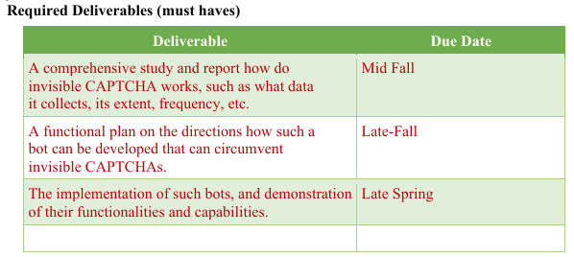
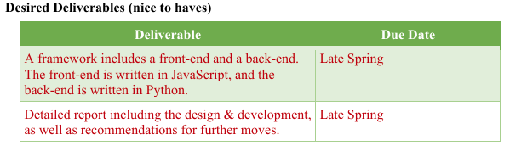
Deliverables
Notes:
Anirudh, Bishesh, David, Diemmi, Hiten, Joseph

Slide 15
Questions/Discussion for Sponsor
N/A
Notes:
Anirudh, Bishesh, David, Diemmi, Hiten, Joseph

